Slide 1

Political Sentiment on Reddit

Slide 2
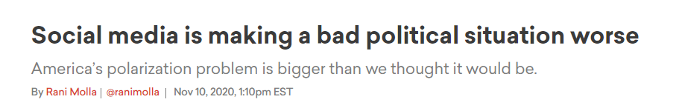
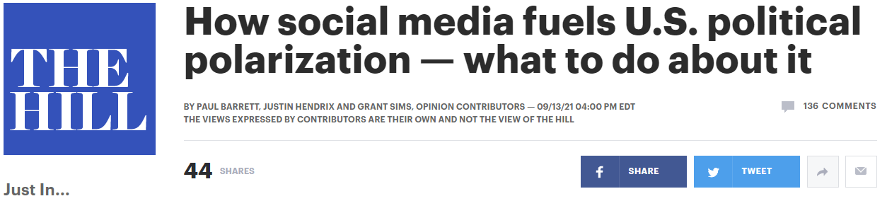
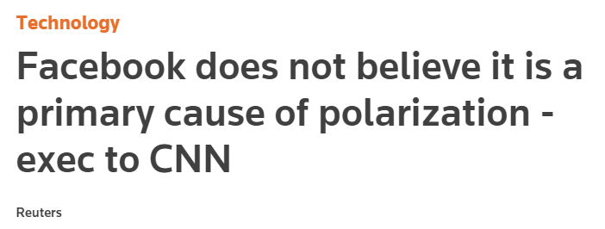
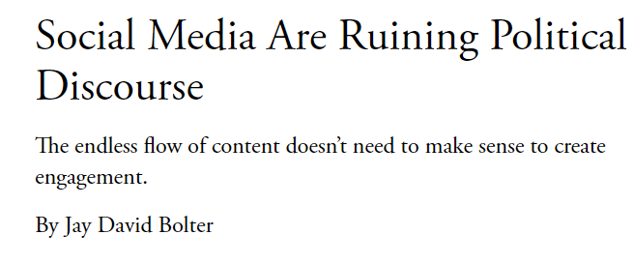
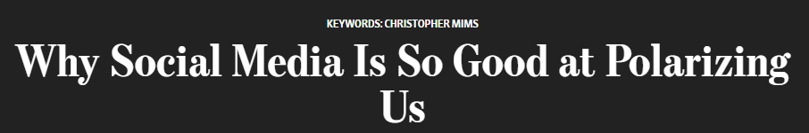
Notes:
The issue of political polarization on social media is frequently discussed but can be challenging to quantify.

Slide 3
The Data
Reddit:
r/politics and r/news: two largest general political subreddits
r/Conservative and r/Libertarian: two largest right-leaning subreddits
r/democrats and r/Liberal: two largest left-leaning subreddits
500k+ comments from about 134k authors
Poll Data from FiveThirtyEight:
Presidential approval data from 40+ different pollsters
Date range: Jan 23 – Sept 15, 2021
Sentiment analysis using TextBlob

Slide 4
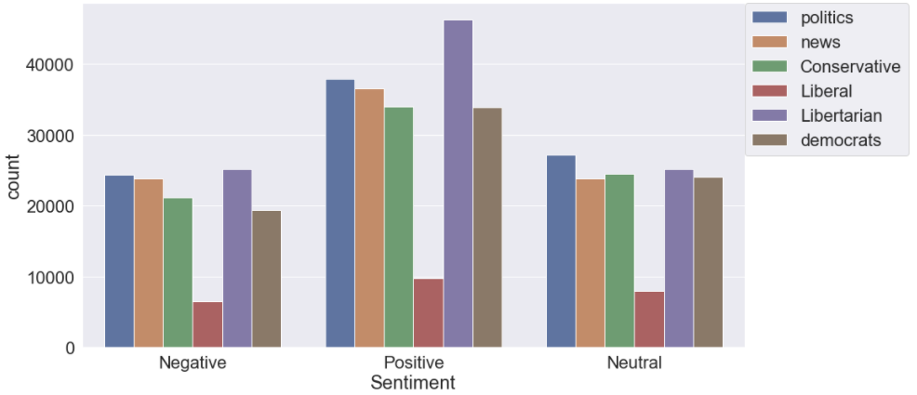
Sentiment of Reddit Posts

Slide 5
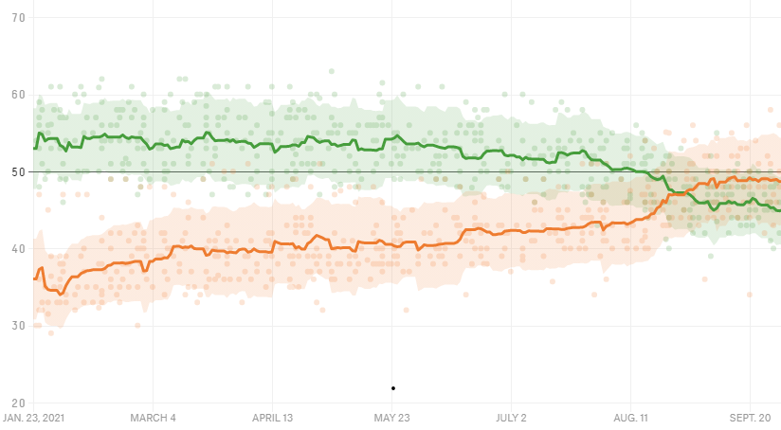

Slide 6
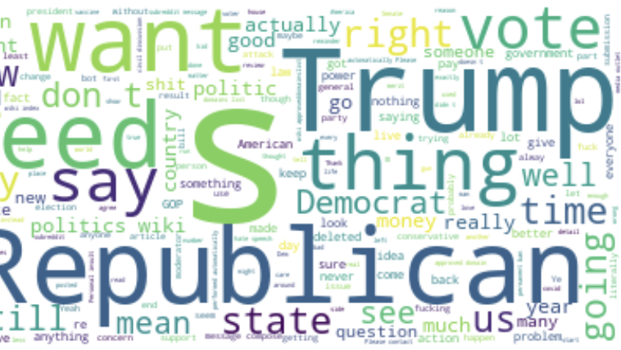
r/politics

Slide 7
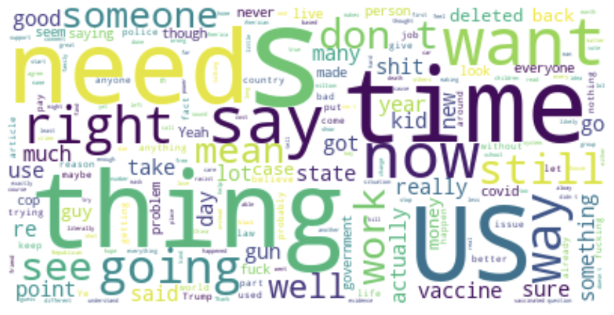
r/news

Slide 8
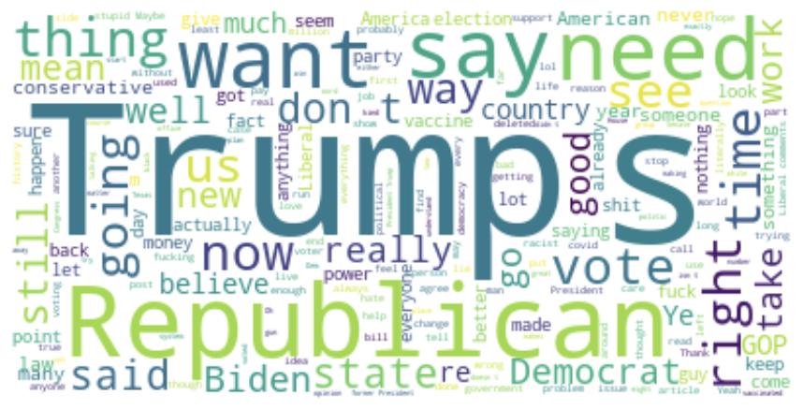
r/liberal

Slide 9
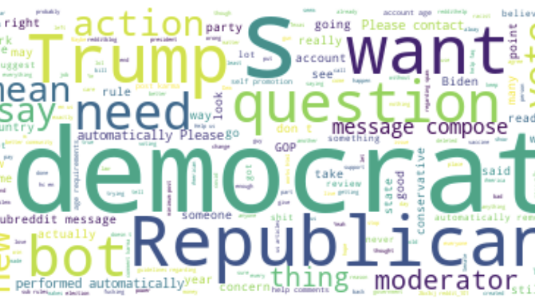
r/democrats

Slide 10
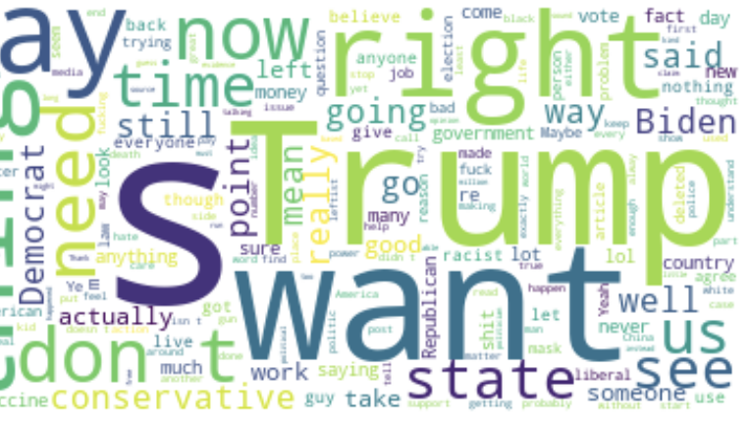
r/conservative

Slide 11
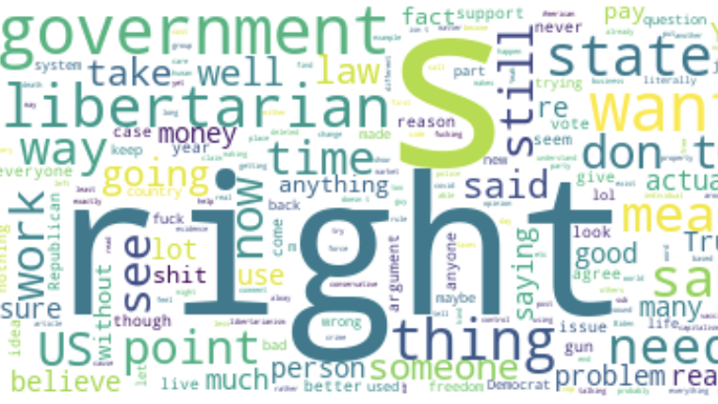
r/libertarian

Slide 12
Modelling Results

Slide 13
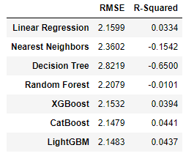

Slide 14
